Slide 1

Movie Sales Analysis
Presented by:
Harish Uppula
Ranjith kumar
Batch:422

Slide 2
AGENDA :
Business Problem
Business Objective
Dataset Overview
Data Cleaning & Transformation
DAX Measures Created
Dashboard Highlights
Key Insights
Challenges Faced
Conclusion

Slide 3
Business Problem :
Movie companies, streaming platforms, and distributors struggle to understand what factors truly drive movie success. With large datasets containing revenue, ratings, genres, votes, directors, and runtimes, it becomes difficult to manually identify:
Which years or genres perform the best
Which directors or movies generate the highest revenue
How ratings, votes, and runtime influence box office performance
Without proper analysis, studios may invest in the wrong genres, choose less impactful directors, or make movies that fail to attract audiences.
A Movie Sales Analysis Dashboard is needed to uncover performance trends, identify top contributors, and support data-driven decisions for future movie production and marketing.

Slide 4
Business Objective :
To analyze IMDb movie data and uncover insights related to movie performance, revenue, genre trends, ratings, and director contribution using Power BI.
Key goals:
Analyze movie performance across years.
Compare revenue & engagement across genres.
Identify top directors and top-grossing movies.
Understand how ratings, votes & runtime affect revenue.
Provide insights for smarter production decisions.
Create an interactive Power BI dashboard for exploration.

Slide 5
Problem Statement:
Movie studios and streaming platforms handle large volumes of movie-related data
Difficulty in identifying key factors that drive movie revenue and success
Lack of clarity on:
  Which genres consistently perform well
  Which directors deliver high-revenue movies
  How ratings, votes, and runtime impact box-office performance
Manual analysis is time-consuming and prone to errors

Slide 6
Dataset Overview :
Total Rows :1000
Total Columns:12
Rank : The position of the movie in the ranking list.
Title : The name of the movie.
Genre : The primary genre(s) of the movie (e.g., Action, Drama).
Description : A brief summary or synopsis of the movie plot.
Director : The name of the movie’s director.
Actors : Names of the main actors featured in the movie.
Year : The year the movie was released.
Runtime (Minutes) : Duration of the movie in minutes.
Rating : The average viewer rating (e.g., IMDb rating).
Votes : Total number of user votes received for the movie.
Revenue (Millions) : Total revenue generated by the movie in millions of USD.
Metascore : The Metacritic score representing critic reviews (0–100 scale).

Slide 7
Data Cleaning & Transformation :
Identified null values in Revenue & Metascore.
Replaced null values with their respective column averages.
Ensured correct data types.
Added new DAX measures for calculations.
Validated data correctness for accurate dashboard visuals.

Slide 8
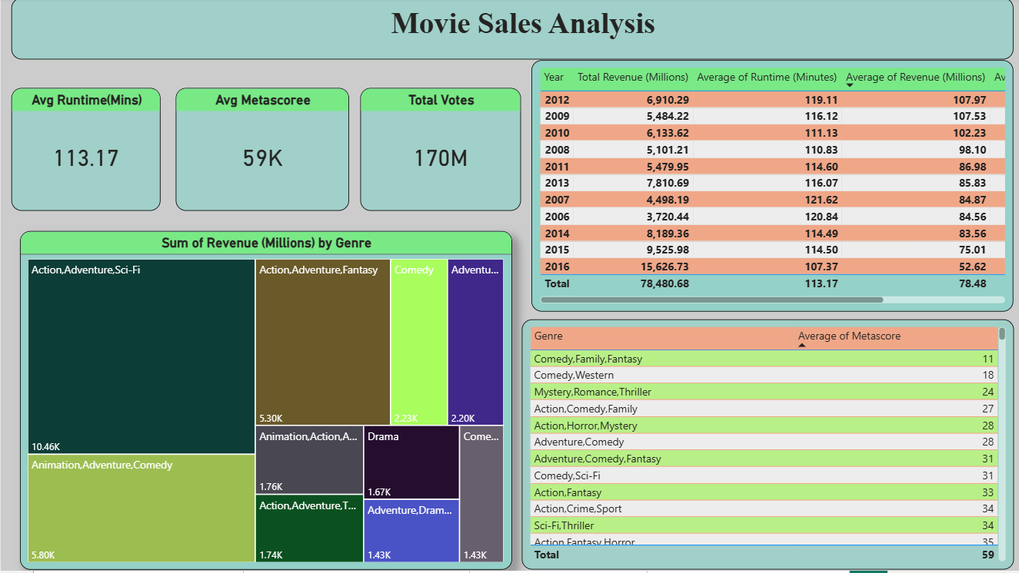

Slide 9
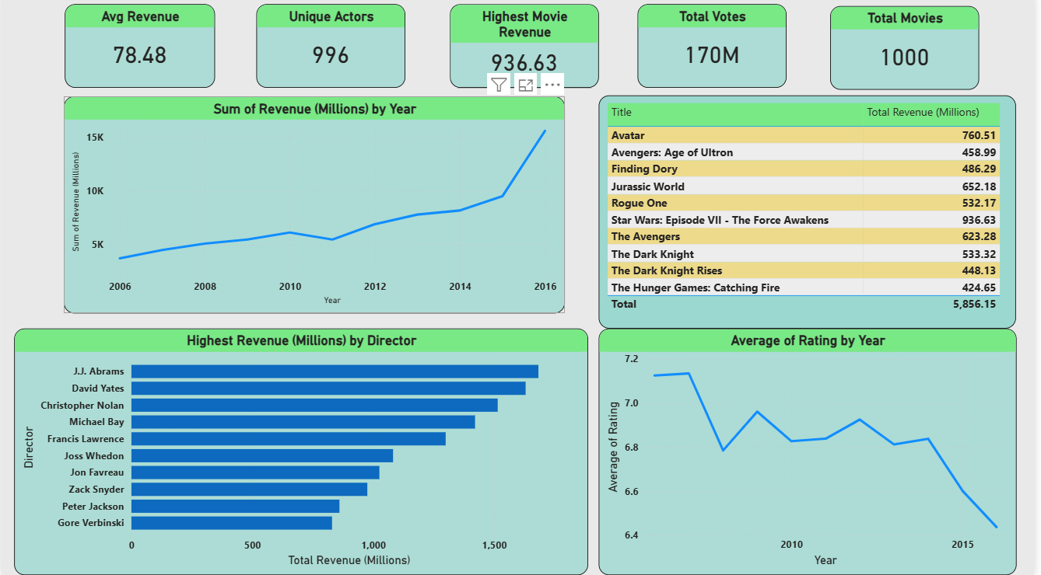

Slide 10
Key Insights :
Movies with higher IMDb ratings generally correlate with higher revenue.
Action and Drama genres lead in revenue and movie count.
Directors with consistent high-grossing films dominate overall revenue.
Medium-length movies tend to achieve better ratings and average revenue.
Audience Engagement Metrics Help Predict Success.

Slide 11
Recommendations:
Focus production and marketing efforts on high-performing genres like Action and Drama
Collaborate more with top revenue-generating directors for better Revenue
Selecting scripts that target medium runtimes, as they show better ratings and revenue
Use ratings and audience votes as early indicators of movie success

Slide 12
Challenges Faced :
Missing & Incomplete Data
Data Type Issues
Complex correlations (rating–revenue, runtime–revenue)
Choosing the most meaningful KPIs

Slide 13
Conclusion :
The Movie Sales Analysis Dashboard successfully provides a complete understanding of movie performance across years, genres, directors, ratings, and audience engagement.
By converting raw IMDB data into interactive insights, the dashboard helps identify what truly drives box-office success.
It highlights trends in revenue, top-performing genres and directors, and the impact of ratings, votes, and runtime on movie outcomes.
This analysis supports better, data-driven decisions for movie production, marketing, budgeting, and content strategy-ensuring that studios and platforms invest in the right movies that connect with audiences and maximize revenue.

Slide 14

THANK YOU

